Slide 1
CFG to PDA
Top down and bottom up PDA

Slide 2
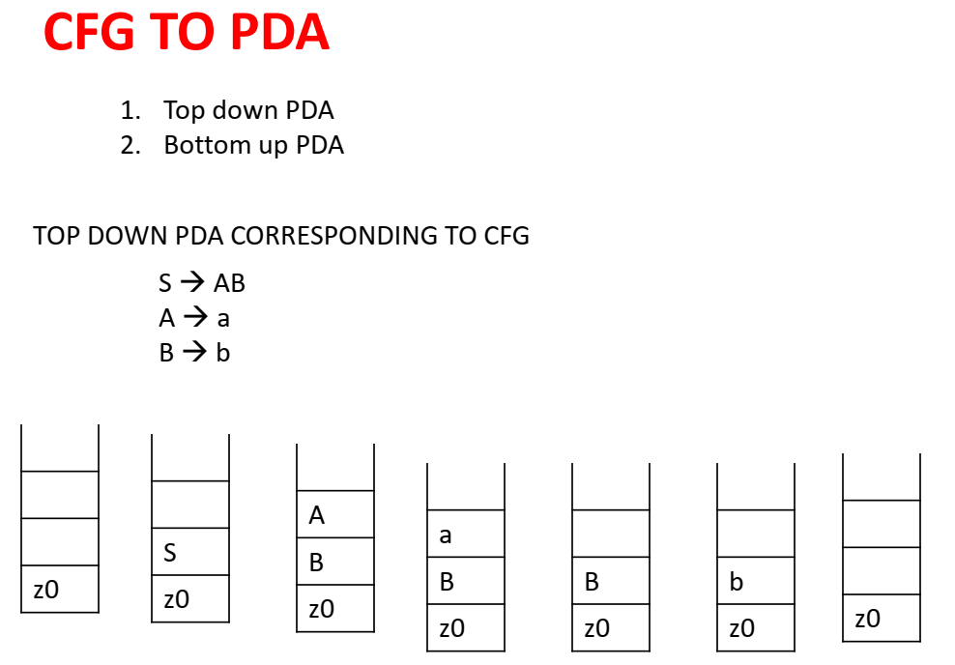
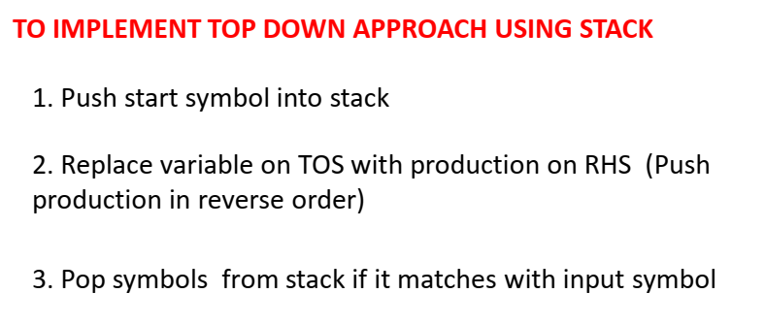
Input String “ab”

Slide 3
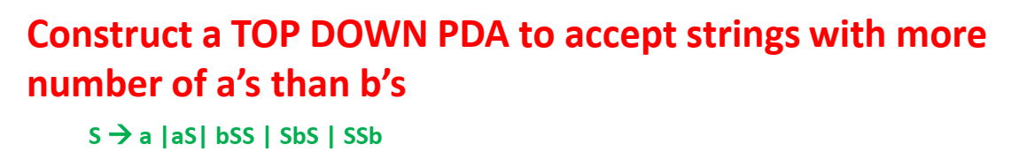
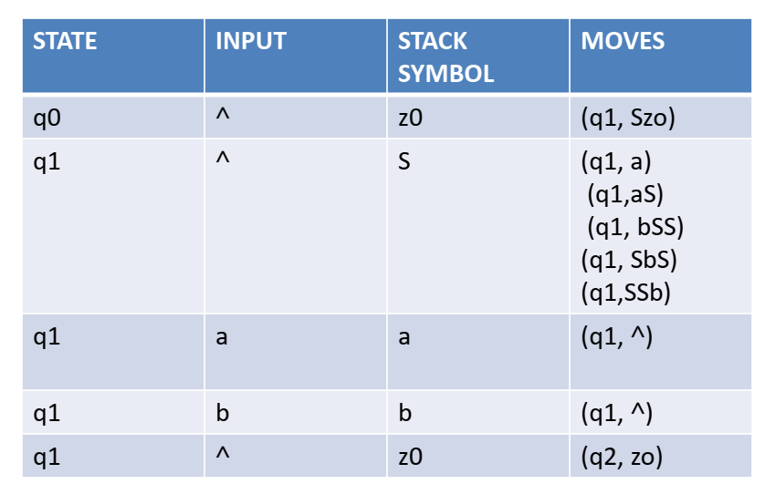
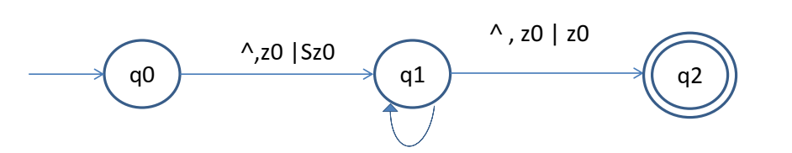
Λ, λ → S
Λ,S→ a
Λ,S→ aS
Λ,S-→ bSS
Λ,S→ SbS
Λ,S→SSb
a,a→Λ
b,b→Λ

Slide 4
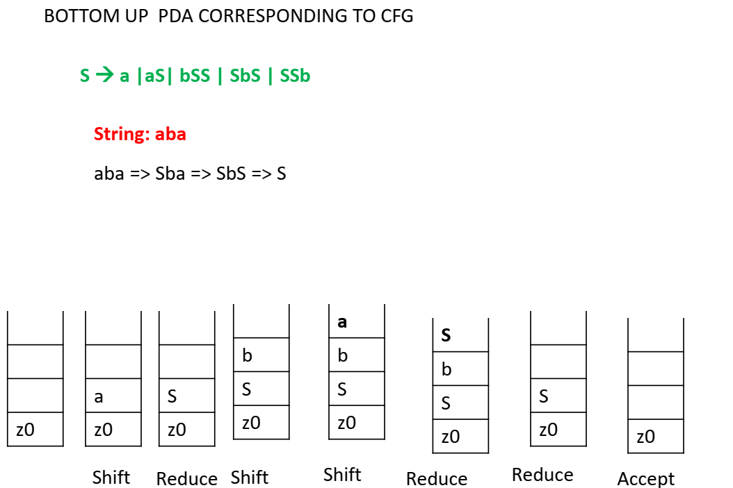
Push inputs ymbol onto stack.
2) Pop top symbol from stack and see if match occurs to RHS of the grammar. If so reduce.
Repeat by popping two, three … symbols and see if match occurs
3) If not push next input symbol onto stack. Repeat steps 2,3 until end of input and ToS is S
Input: “aba”

Slide 5
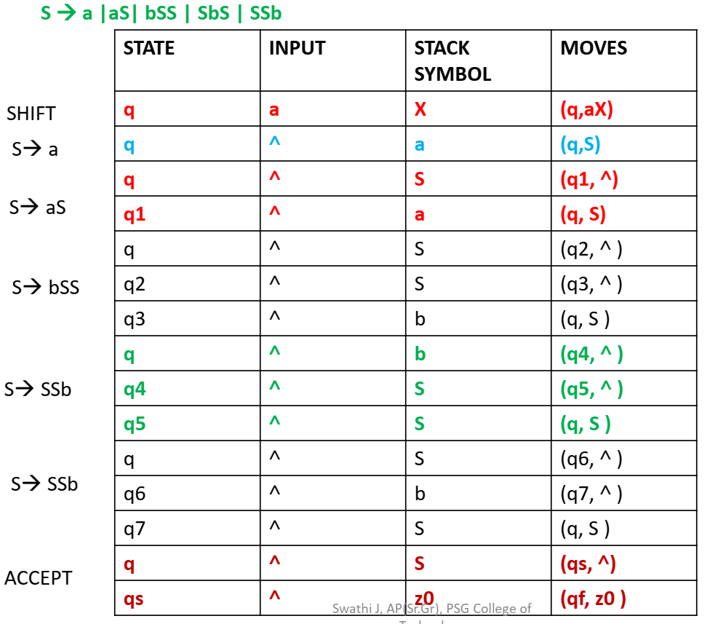

Slide 6
Design top down and bottom up parsers for
S → S+X | X, X → X*Y | Y, Y → (S) | id
S → aSb | ab

